Slide 1
Bloom Filter
Lecture 8

Slide 2
Background
Space efficient, probabilistic data structure for querying membership introduced by Burton Bloom in 1970.
It tells us whether a search key is definitely not in the set or may be in the set.
Uses in dictionaries, DBs, and Blocked URL check in Chrome browser.

Slide 3
Two Bloom Filters operations:
The ability to add an extra object ‘x’ to the set ‘S’.
To determine whether a given object ‘x’ is a member of set ‘S’.

Slide 4
Compare to Hashed Based Approach
Hashed based approach has higher false positive element probability.
It requires more memory space.
The query cost is much higher than the hashed based approach.
It does not store the object itself.

Slide 5
How Bloom Filter Works?
M bits array (initially set to 0) with K hash functions.
add(key):
count = 0
do
count++
Index = next_hash_function(key)
Array[ index ] = 1
While count < K

Slide 6
How Bloom Filter works?
is_member(key):
count = 0
do
count++
index = next_hash_function(key)
While ( count < K ) OR ( isContains(array[ index ]) )
If count == K then:
Return True
Else:
Return False

Slide 7
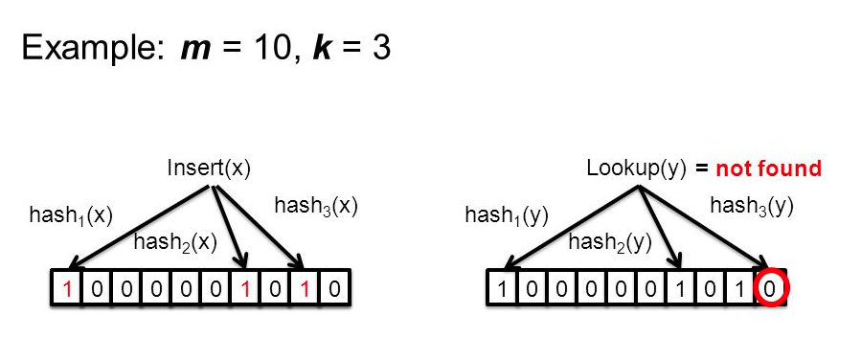
How Bloom Filter Works?

Slide 8
Demo
https://www.jasondavies.com/bloomfilter/

